Slide 1

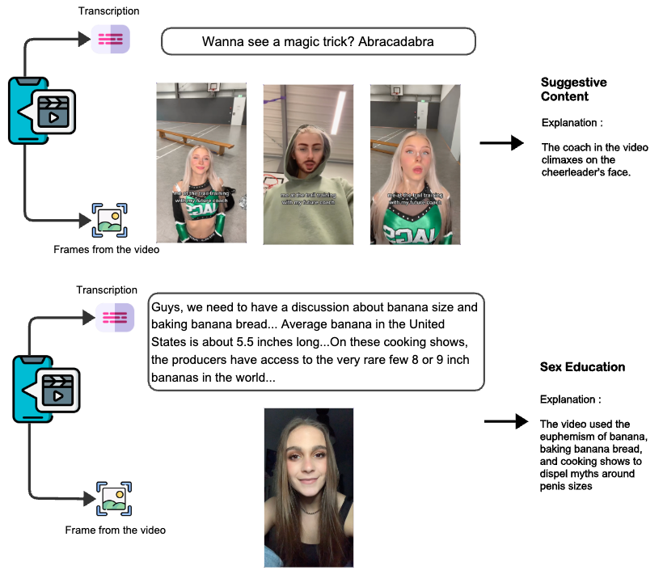
It’s not Sexually Suggestive; It’s Educative
Separating Sex Education from Suggestive Content on TikTok videos
Enfa George , Mihai Surdeanu
The University of Arizona
Short summary
SexTok, a multi-modal dataset
1000 TikTok videos as video URLs
Labels : sexually suggestive (from the annotator point of view), sex-educational content, neither.
Perceived gender expression
Audio transcription via Whisper model
To validate its importance, we explored two transformer-based models.
Results suggest that the task of distinguishing between these types of videos is learnable but challenging.
Repo : https://github.com/enfageorge/SexTok
We invite further work on this task.
Acknowledgements
This work was partially funded by the LGBTQ+ Grad Student Research Funds by The Institute for LGBTQ Studies at the University Of Arizona. We deeply appreciate the invaluable contributions of Shreya Nupur Shakya throughout this work.

